Slide 1
Department of Genetics Postgraduate Open House
July 2024

Slide 2
Our Department
The Department of Genetics is host to around 50-65 postgraduate students at any given time. They work on a wide range of problems of modern biology, from population genetics and ecology, to the detailed analysis of the transcriptome.
The Department has its core in the Genetics Building on the Downing site and is host to a number of enterprises which highlight our open and interactive spirit. In addition, it has homegrown ties with;
Department of Engineering
Cavendish Laboratory
Gurdon Institute
Cambridge Institute for Medical Research, etc.
These interactions act as showcases for a varied offer of courses and seminars from the different institutes which challenge and develop students.

Slide 3
Our programmes
MPhil Genetics (Research Only)
12 months full-time
2 years part-time
Please note: part-time study may not always be viable and will be considered on a case-by-case basis, so please discuss this option with your proposed supervisor before making an application for this mode of study.
Applicants for this course should have achieved a UK Good II.i Honours Degree.
If your degree is not from the UK, please check International Qualifications to find the equivalent in your country.
University Minimum Academic Requirements link
PhD Genetics (Research Only)
3-4 years full-time
5-7 years part-time
Please note: part-time study may not always be viable and will be considered on a case-by-case basis, so please discuss this option with your proposed supervisor before making an application for this mode of study.
Applicants for this course should have achieved a UK Good II.i Honours Degree.
If your degree is not from the UK, please check International Qualifications to find the equivalent in your country.
University Minimum Academic Requirements link

Slide 4
Related programmes
The MPhil in Biological Sciences is offered by the Faculty of Biology as a full-time period of study and research, and introduces students to research skills and specialist knowledge in the Faculty's key research areas or 'pathways'.
These include:
-Biomolecular Science
-Cell Science
-Crop Science
-Developmental Biology
-Infection Biology & Molecular Immunology
-Reproduction & Embryogenesis
Prospective students to apply directly to the pathway of their choice.
If you have any questions please reach out to the MPhil Co-ordinator anita.kovacs@admin.cam.ac.uk

Slide 5
MPhil Course Outcomes
Most MPhil candidates start in October, to take advantage of Departmental and University induction programmes and funding opportunities, but admission in January or April is also possible.
The examination consists of a thesis, not more than 20,000 words in length, exclusive of tables, footnotes, bibliography, and appendices. The assessment also includes an oral examination on the thesis and on the general field of knowledge within which it falls.
Please note: part-time study may not always be viable and will be considered on a case-by-case basis, so please discuss this option with your proposed supervisor before making an application for this mode of study.
Learning Outcomes
By the end of the programme, students will have:
a comprehensive understanding of techniques, and a thorough knowledge of the literature applicable to their own research;
demonstrated originality in the application of knowledge, together with a practical understanding of how research and enquiry are used to create and interpret knowledge in their field;
shown abilities in the critical evaluation of current research and research techniques and methodologies; and
demonstrated some self-direction and originality in tackling and solving problems, and acted autonomously in the planning and implementation of research.

Slide 6
PhD Course Outcomes
PhD students undertake three to four years of research supervised by one of our group leaders, where they will develop an original research question and address this through laboratory or computer-based research.
Students undertake specific training in their research area as well as more generic skills training during their degrees as well as have opportunities to supervise undergraduate students. Students are expected to submit their thesis by the end of their fourth year.
Towards the end of their first year of study, students are required to complete a satisfactory first-year report and viva.
Most PhD candidates start in October, to take advantage of Departmental and University induction programmes and funding opportunities, but admission in January or April is also possible.
Please note: part-time study may not always be viable and will be considered on a case-by-case basis, so please discuss this option with your proposed supervisor before making an application for this mode of study.
Learning Outcomes:
a comprehensive understanding of techniques, and a thorough knowledge of the literature applicable to their own research;
demonstrated originality in the application of knowledge, together with a practical understanding of how research and enquiry are used to create and interpret knowledge in their field;
shown abilities in the critical evaluation of current research and research techniques and methodologies;
demonstrated self-direction and originality in tackling and solving problems, and acted autonomously in the planning and implementation of research;
independence in designing and conducting a substantial body of original research, and preparing that data in a format suitable for publication in peer-reviewed journals.

Slide 7
Application Requirements
In order to apply for either MPhil or PhD course you'll need to think about getting a few things ready before you apply.
Two academic references
Transcript
CV/resume
Evidence of competence in English If required - you can check using our tool
Proposed Supervisor (Mandatory)
Statement of Interest (Mandatory)
Research experience (Mandatory)
Research Proposal (Optional)
*There is no set age limitation, however students must complete a Bachelor's Degree, and achieved a UK Good II.i Honours Degree to meet their academic conditions.

Slide 8
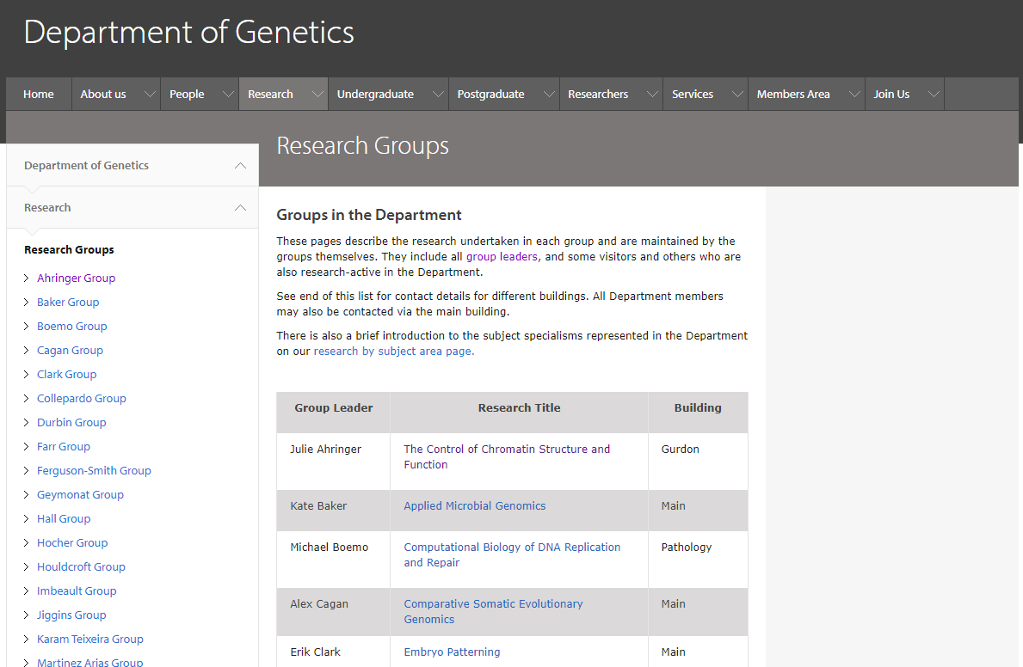
How to Find a Supervisor
Prospective students must identify a potential supervisor (or supervisors) in the Department before applying. Supervisors and their research areas are listed on the Department of Genetics website.
Applicants must contact prospective supervisors to discuss potential projects before a formal application.

Slide 9
Application Requirements
2) Does work experience as a genome analyst help in making the application stronger or is the experience only valuable if it's research assistantship?
3) minimum publication requirements
6) Do GRE scores hold weightage?

Slide 10
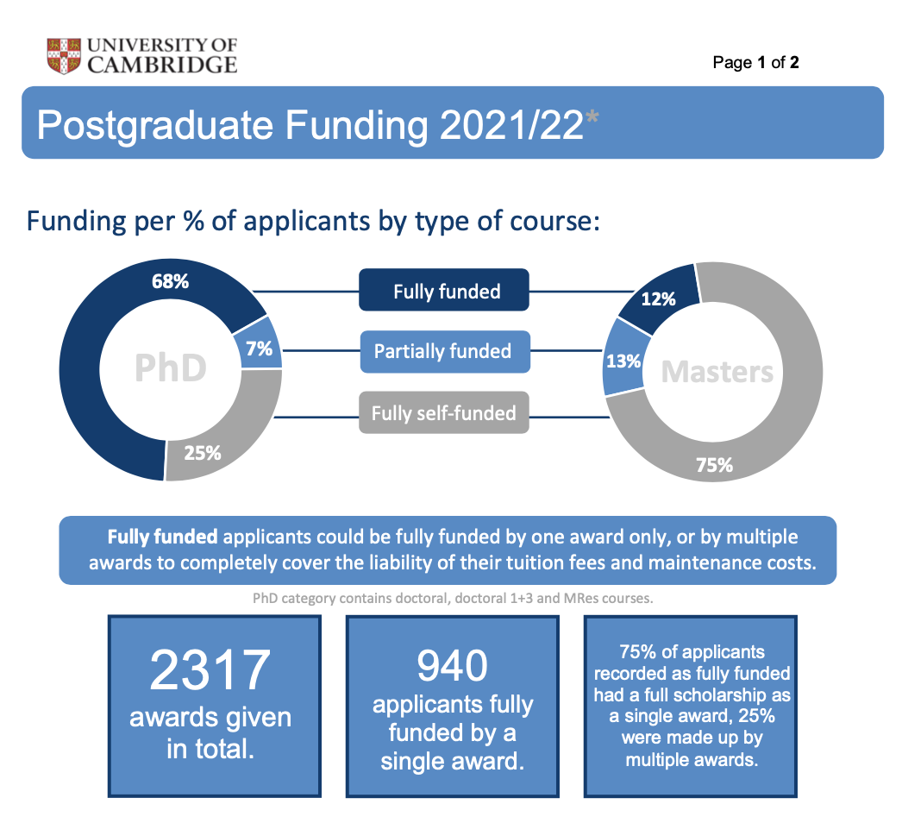
Funding Competition
Every year the University of Cambridge awards over £100m in scholarships to new postgraduate students, from a number of University and College endowments as well as government Research Council (UKRI) funds. Many students also fund their studies from external sources, such as loans, charities or government schemes.
We recommend you carefully read the links below to help you understand what is required of you, and what funding opportunities Cambridge offers. There are two major funding deadlines, GATES US (Application deadline is typically October, please check their website over the summer) and the University Funding competition (Application deadline* Dependent on your course – for our department it is 4 January 2025)
The major internal sources of funding are: Cambridge Trust, Gates Cambridge Trust, Harding Distinguished Postgraduate Scholars Programme, Research Councils and collectively College and departmental schemes. Please use the student funding link to help with your search, https://www.student-funding.cam.ac.uk/ .
Helpful funding links
PhD in Genetics | Postgraduate Admissions (cam.ac.uk)
Funding | Postgraduate Admissions (cam.ac.uk)
Welcome - Postgraduate Funding Search (cam.ac.uk)
Cambridge University Scholarship Deadlines | Gates Cambridge
Scholarships (cambridgetrust.org)

Slide 11
Gates Funding Competition Details
Applications for the academic year 2025-26 entry will open in September 2024.
The US Gates Cambridge Scholarship deadline will be confirmed as we get closer to the admission cycle, however the deadline if typically, early to mid-October.
Gates Cambridge manages two selection rounds each year; full details are below, If after reading the details below you are not sure in which round you should apply please email info@gatescambridge.org with details.
US Citizen: This is the earlier round for applicants who are both US citizens and currently resident in the United States; it is specific to Gates Cambridge. Students meeting these criteria must apply by the Fall deadline and submit all their documents by this date (including references), they are not eligible for the later round. US citizens who are studying/working overseas at the time of application should apply in the later round (see below).
All other eligible applicants The large majority of applicants will apply in this round, which is aligned with the University’s postgraduate funding competition. There are two possible application deadlines and these are based on the course to which you are applying, the Department of Genetics follows the January 4th Deadline.
* Please apply by the Graduate Funding Competition deadline referenced in the University Course Directory.
*Whether or not you are eligible for a Gates Cambridge Scholarship you may be eligible for other funding offered by the University of Cambridge. See www.student-funding.cam.ac.uk for more details.

Slide 12
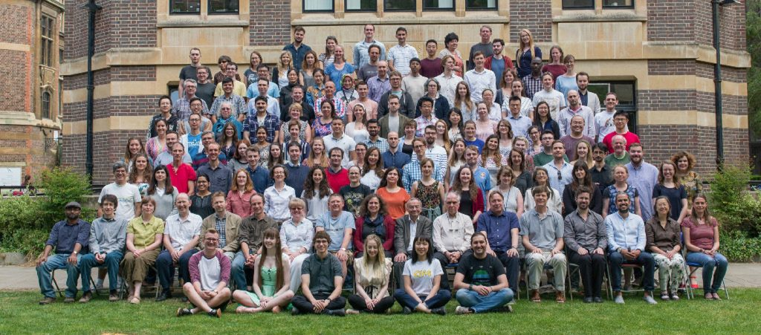
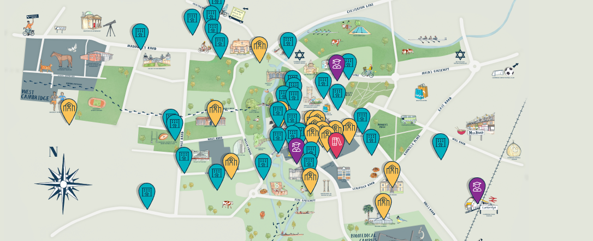
Cambridge Virtual Postgraduate Open Days 2024
4th – 15th November 2024
This is your chance to find out all about postgraduate study at Cambridge.
Chat with current students and academics, gain practical advice and find out whether
Cambridge is the right place for you.
To be notified when booking opens, sign up for their newsletter here! .
https://www.postgraduate.study.cam.ac.uk/openday
What to expect
Warm-up webinars (30 August – 25 September)
Start preparing with warm-up webinars. These cover a range of topics primarily focused on practical aspects of making an application to Cambridge.
College vists (in person) (19 – 23 September, date depending on College)
Open Days Week 1 (4 – 8 November)
Join us live, for online sessions, covering all our courses and subject areas:
Find out more about our courses and explore your subject
Chat with academics, current students and other staff
Open Days Week 2 (11 – 15 November)
Love online sessions, covering different areas of support:
Discover more about the Colleges
Learn about funding opportunities
Discover what pastoral support is available
The Insititute of Continuing Education
Watch recordings of subject sessions from the previous week
On-demand content
Anyone who signs up for any of the above events will receive access to on-demand videos on the practicalities of applying to Cambridge.
Virtual Tour
Explore Cambridge in your own time, using 360 degree photography, videos and photo galleries in a Virtual Tour.

Slide 13
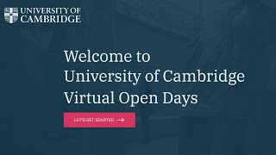
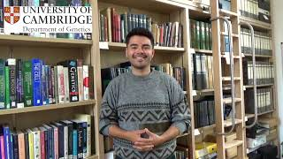
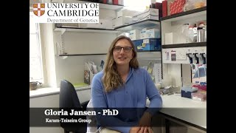
Cambridge Virtual Postgraduate Open Days 2024
Check out the below University Open Day video and some of our student testimonials
Cambridge Open Days - YouTube
Cambridge Open Days - YouTube
Department of Genetics - University of Cambridge - YouTube

Slide 14
Helpful Links
Postgraduate Admissions pg.admissions@admin.cam.ac.uk
International Student Office international.students@admin.cam.ac.uk
International Student Office Visa Guidance international.students@admin.cam.ac.uk
Cambridge Students Page, https://www.cambridgestudents.cam.ac.uk/
Contact Us (cambridgetrust.org) Cambridge.Trust@admin.cam.ac.uk
Cambridge life | Cambridge students https://www.cambridgestudents.cam.ac.uk/cambridge-life
Search - Postgraduate Funding Search (cam.ac.uk) https://www.student-funding.cam.ac.uk/

